Slide 1
LESSONS LEARNED, EXPERIENCE GAINED, DURING AND AFTER THE CHART COURSE 2018
IHO – NIPPON FOUNDATION
ALUMNI SEMINAR
Lieutenant Commander(H) UN Hewahakmanage

Slide 2
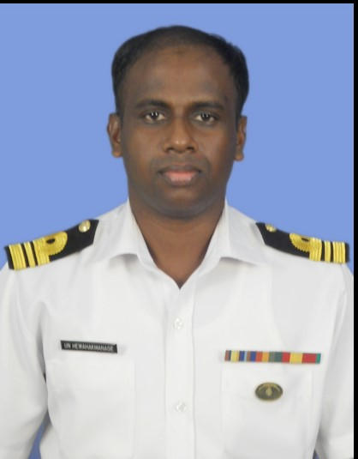
Self introduction
IHO – NIPPON FOUNDATION
ALUMNI SEMINAR
Name | U N Hewahakmanage
Alumni year | 2017
Country | Sri Lanka
Organization | Sri Lanka Navy Hydrographic Services
Position/Job title | Manager GIS & Cartography / A/ Senior Manager Administration
Current job description | Assist for production of ENCs, Paper Charts, Defence Charts and other Thematic Maps and handling of administrative work of hydrographic service
Please put your photo here!

Slide 3
My career path and projects / Achievements
IHO – NIPPON FOUNDATION
ALUMNI SEMINAR
Joined Sri Lanka Navy on July 2001.
Completed Basic Degree in BSc (Naval Science) from University of Goa in 2004.
Completed Basic Hydrography (IHO-cat ‘B’) course from National Institute of Hydrogrpahy-India in 2012.
Completed Long Hydrography (IHO- Cat ‘A’)course from National Institute of Hydrogrpahy-India in 2017.
Awarded with MSc (Hydrography) Degree from University of Goa 2017.

Slide 4
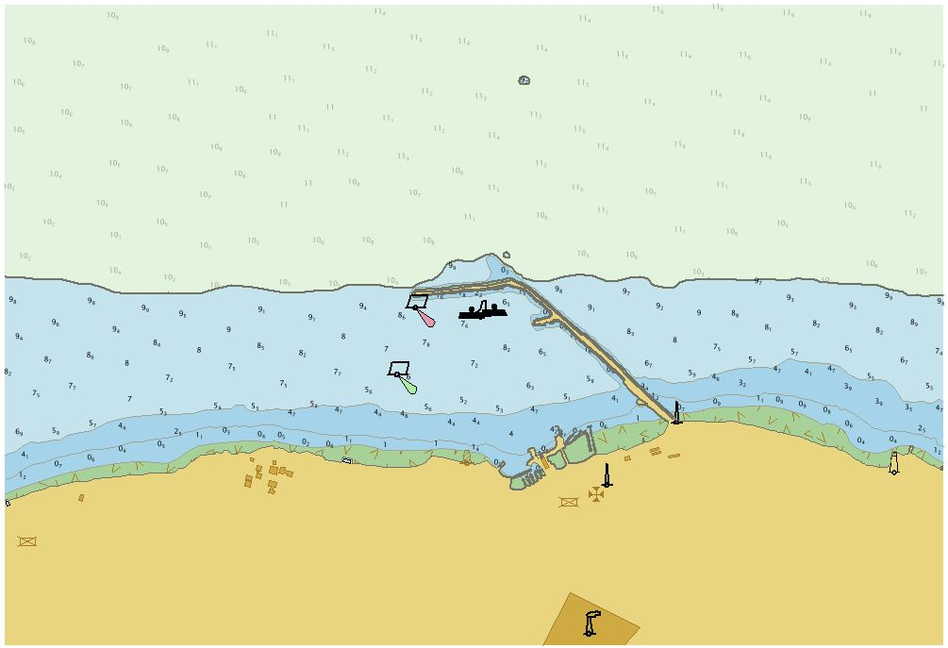
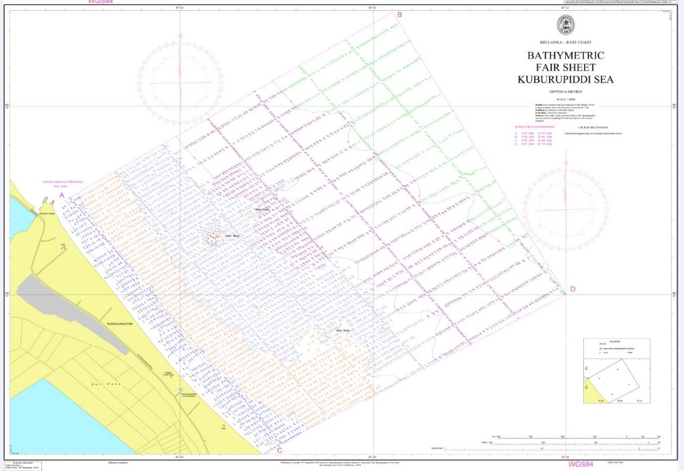
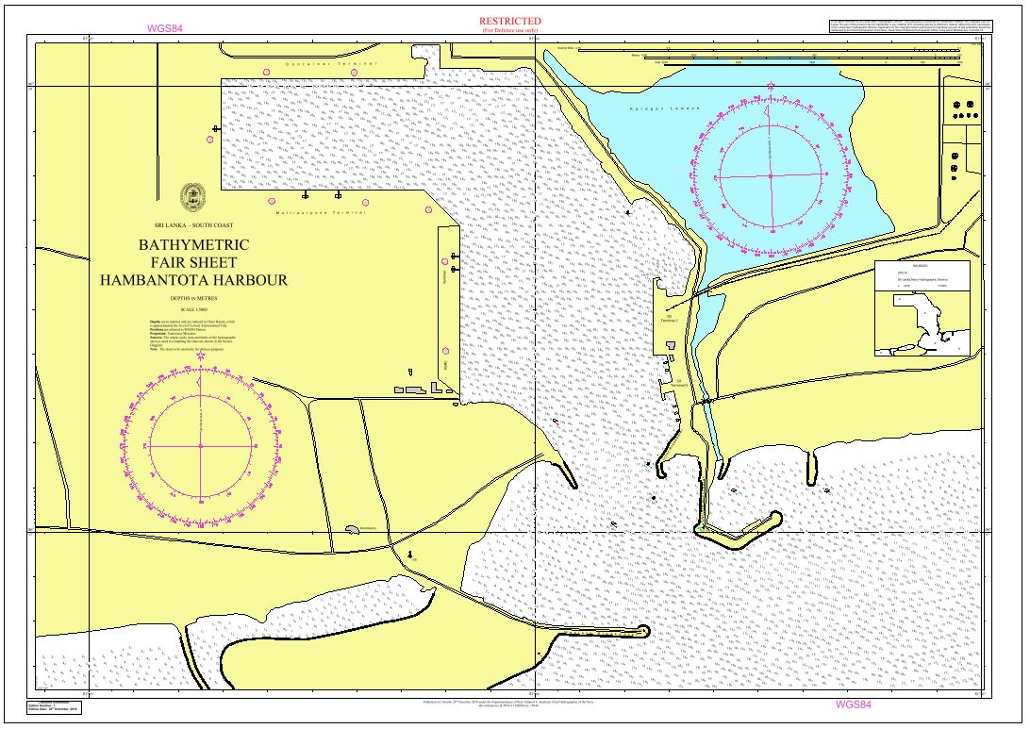
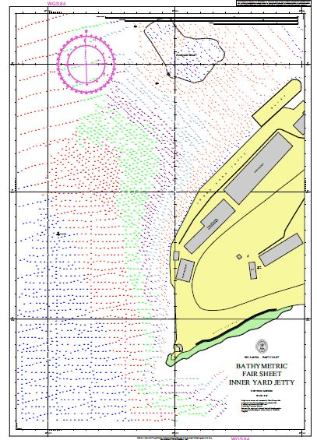
My career path and projects / Achievements
IHO – NIPPON FOUNDATION
ALUMNI SEMINAR

Slide 5
Lessons learned from CHART Course
IHO – NIPPON FOUNDATION
ALUMNI SEMINAR
Gain knowledge on cartographic work
Learn about new cartographic software like Caris S-57 composer, Paper chart composer etc.
Learnt about cartographic standards used in world
Problems in getting quality data

Slide 6
Lessons learned from CHART Course
IHO – NIPPON FOUNDATION
ALUMNI SEMINAR
Legal aspects of Chart production
Awareness on what are the sources used for chart production
Learn about preparation of Nav warnings, Notices to mariners
Awareness on data assessment and ENC production
SOLOAS Obligation

Slide 7
Suggestion for the future
IHO – NIPPON FOUNDATION
ALUMNI SEMINAR
Continue present system as it provide knowledge on marine cartography as well as develop comradeship among the participants
Provide knowledge on raster ENC production
Provide knowledge on conversation of other data formats for use with cartographic software
Inclusion of aspects of S-100

